Slide 1
Section 3.8 Exponential Growth and Decay

Slide 2
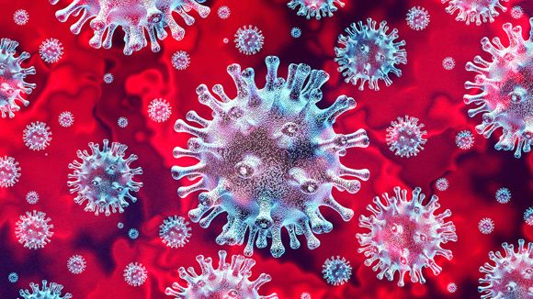
In many natural phenomena, the growth (or decay) in quantity can be modelled by an exponential function.
For example, if one person is infected with COVID-19, and on average each person will spread it to 3 other people, then the 3 people will spread the virus to 9 other people. And if we repeated this process 10 time, the number of people infected will be 3¹⁰ = 59,049.
We can model this growth by an exponential function y(t) = 3^{t} .
What is so special about this function is that when you differentiate it, you get
$$\frac{d}{dt}y\left(t\right)=\frac{d}{dt}3^{t}=3^{t}\left(ln3\right)=\left(ln3\right)y(t)$$
In other words, the derivative is a constant multiple of the original function.

Slide 3
Mathematicians proved that if any function y(t) whose derivative is a constant times the function y(t) itself, then this function must be an exponential function, and the base can be assumed to be the number “e”,
by adjusting the constant if necessary.
k is called the relative growth rate
$\frac{dy}{dt}$ is called the growth rate.

Slide 4
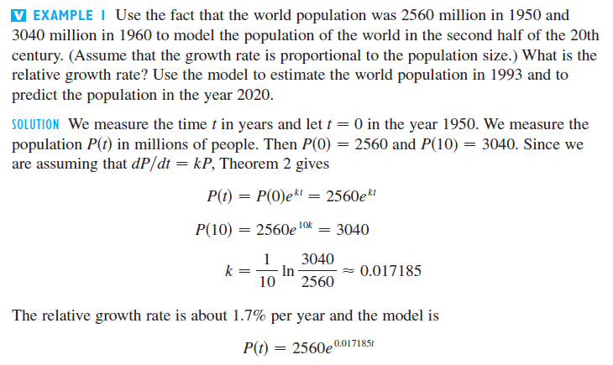
This means $\frac{dP}{dt}=kP$

Slide 5
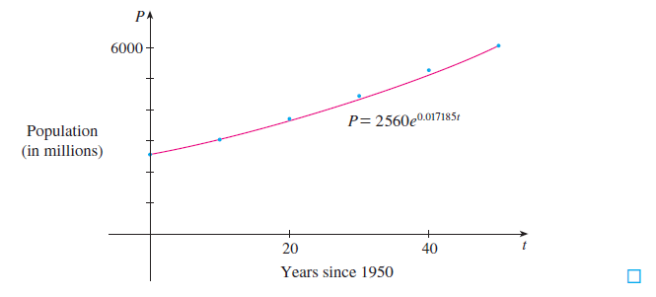

Slide 6
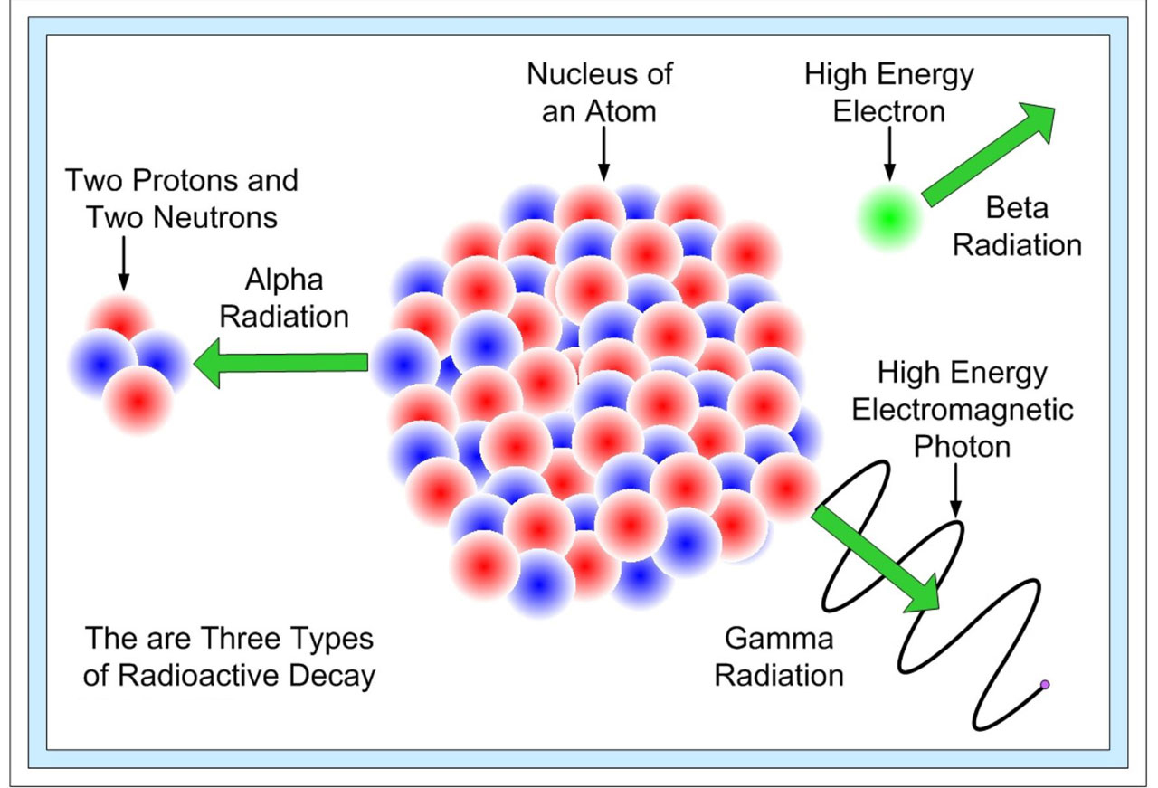
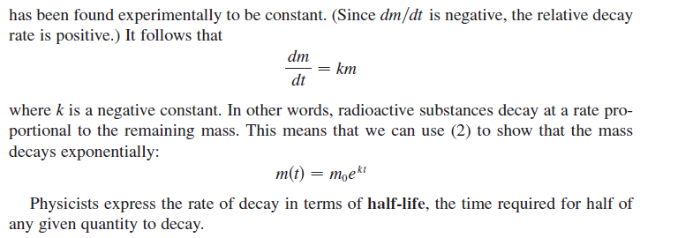

Slide 7
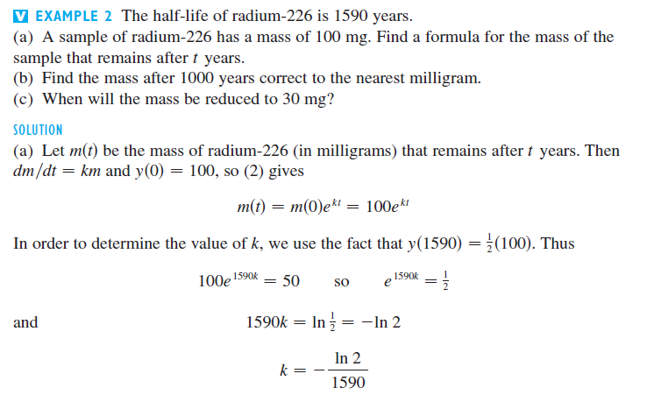

Slide 8
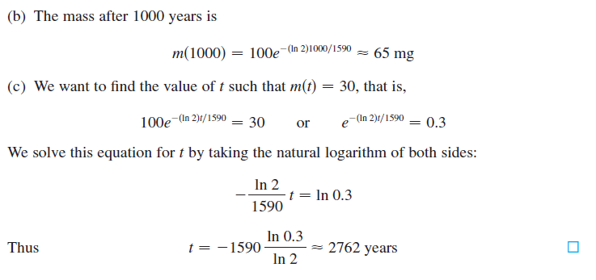

Slide 9
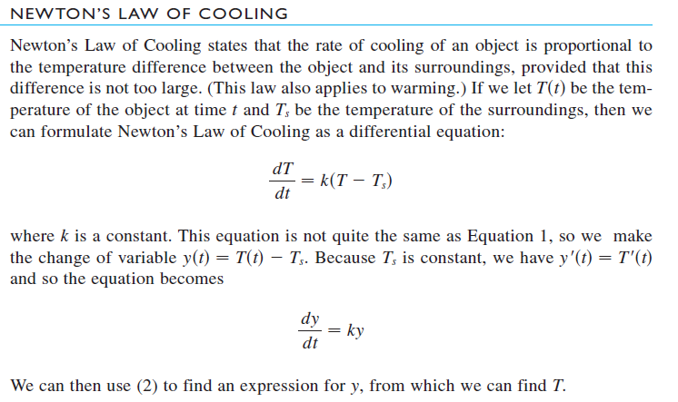
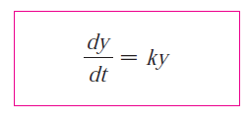
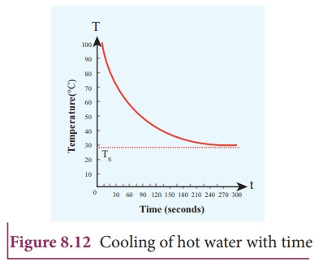

Slide 10
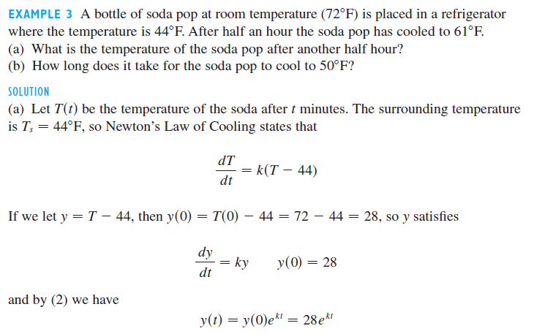
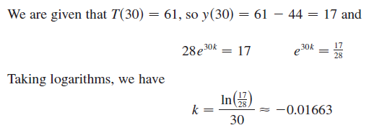

Slide 11
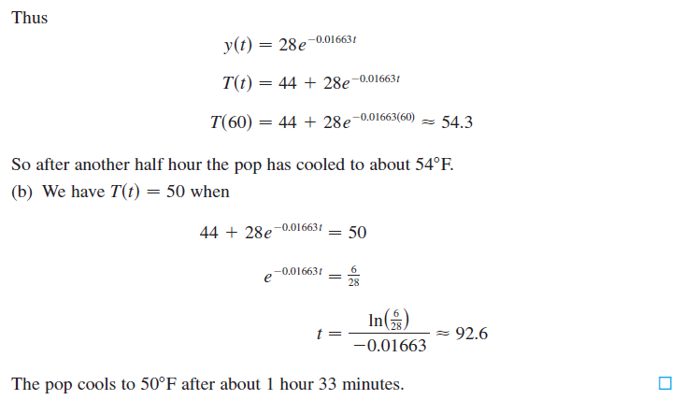
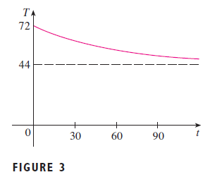

Slide 12
EXAMPLE 4 An application in forensic science.
A person was found dead inside his apartment at 8pm. His body temperature was 78°F when found, and then measured again to be 76°F an hour later. If the room temperature was 70° and we assume that the person’s body temperature was 98.6°F (same as an average person) when he was alive, deduce the time that he was “murdered”.
Solution:
Set t = 0 at 8pm, and thus t = 1 at 9pm. T_{s} = 70 and let y(t) = T – 70.
$$y\left(t\right)=y(0)e^{kt}$$
$$y\left(0\right)=78 −70=8.$$
$$y\left(1\right)=76 −70=6.$$
$$ y\left(1\right)=y\left(0\right)e^{k\left(1\right)} ⇒ 6=8e^{k}$$
$∴k=\ln\left(\frac{6}{8}\right)=−0.2877$
$$y\left(t\right)=8e^{−0.2877t}$$
We will use this formula to find t when y(t) = 98.6 – 70

Slide 13
Solution:
Set t = 0 at 8pm, and thus t = 1 at 9pm. T_{s} = 70 and let y(t) = T – 70.
$$y\left(t\right)=y(0)e^{kt}$$
$$y\left(0\right)=78 −70=8.$$
$$y\left(1\right)=76 −70=6.$$
$$ y\left(1\right)=y\left(0\right)e^{k\left(1\right)} ⇒ 6=8e^{k}$$
$∴k=\ln\left(\frac{6}{8}\right)=−0.2877$
$$y\left(t\right)=8e^{−0.2877t}$$
Just before the person died, his temperature should be 98.6, hence y(t) = 98.6 – 70 = 28.6
Plug this into the equation, we have $28.6 = 8e^{−0.2877t}$
From this we can calculate t = -4.428 (negative means before 8pm), hence it is about 3:34pm.

Slide 14
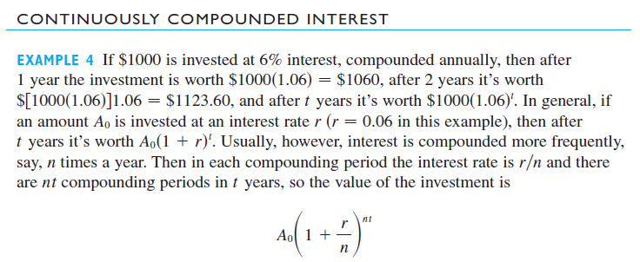
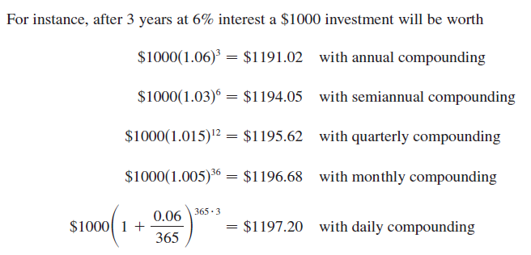
EXAMPLE 5

Slide 15
